Slide 1
Capstone Project
Hotel Booking Analysis
BY
MOHAMMAD SHUAIB.
KAUSHIK DEY.

Slide 2
Point of Discussion
Problem statement.
Business Objective.
Project summary or Data summary.
Variable Description.
Data Cleaning and Manipulation.
Check Unique Values for each variable.
Exploratory Data Analysis (EDA).
Solution to Business Objective.
Conclusion.

Slide 3
Problem statement :
The aim of this analysis is to identify important features that can affect hotel bookings and help hotel businesses make intelligent decisions to penetrate the market and gain more market share. Additionally, the project seeks to help customers in deciding the best period to visit places while availing low accommodation cost benefits.
Business Objective.
The project's objective is to provide insights that will help the hotel industry make informed decisions to improve their business performance and customer satisfaction.

Slide 4
Project summary or Data summary.
The dataset includes booking information for two hotels - City Hotel and Resort Hotel - containing various criteria such as booking season, time, length of stay, number of guests, parking, pricing, and market segment. The main goal is to conduct Exploratory Data Analysis to explore and scrutinize the dataset and identify significant features that can enhance bookings and help hotels penetrate the market to attract more customers. By analyzing booking and pricing trends, important insights can be derived to make intelligent business decisions. Additionally, the secondary objective is to assist customers in determining the best time to visit a place to obtain low accommodation costs.

Slide 5
Variables Description :
hotel : Hotel(Resort Hotel or City Hotel)
is_canceled : Value indicating if the booking was canceled (1) or not (0)
lead_time : * Number of days that elapsed between the entering date of the booking into the PMS and the arrival date*
arrival_date_year : Year of arrival date
arrival_date_month : Month of arrival date
arrival_date_week_number : Week number of year for arrival date
arrival_date_day_of_month : Day of arrival date
stays_in_weekend_nights : Number of weekend nights (Saturday or Sunday) the guest stayed or booked to stay at the hotel
stays_in_week_nights : Number of week nights (Monday to Friday) the guest stayed or booked to stay at the hotel
adults : Number of adults
children : Number of children
babies : Number of babies
meal : Type of meal booked. Categories are presented in standard hospitality meal packages:
country : Country of origin.

Slide 6
Variables Description :
market_segment : Market segment designation. In categories, the term “TA” means “Travel Agents” and “TO” means “Tour Operators”
distribution_channel : Booking distribution channel. The term “TA” means “Travel Agents” and “TO” means “Tour Operators”
is_repeated_guest : Value indicating if the booking name was from a repeated guest (1) or not (0)
previous_cancellations : Number of previous bookings that were cancelled by the customer prior to the current booking
previous_bookings_not_canceled : Number of previous bookings not cancelled by the customer prior to the current booking
reserved_room_type : Code of room type reserved. Code is presented instead of designation for anonymity reasons.
assigned_room_type : Code for the type of room assigned to the booking.
booking_changes : Number of changes/amendments made to the booking from the moment the booking was entered on the PMS until the moment of check-in or cancellation
deposit_type : Indication on if the customer made a deposit to guarantee the booking.

Slide 7
Variables Description :
agent : ID of the travel agency that made the booking
company : ID of the company/entity that made the booking or responsible for paying the booking.
days_in_waiting_list : Number of days the booking was in the waiting list before it was confirmed to the customer
customer_type : Type of booking, assuming one of four categories
adr : Average Daily Rate as defined by dividing the sum of all lodging transactions by the total number of staying nights
required_car_parking_spaces : Number of car parking spaces required by the customer
total_of_special_requests :Number of special requests made by the customer (e.g. twin bed or high floor)*
reservation_status : Reservation last status, assuming one of three categories
Canceled – booking was canceled by the customer
Check-Out – customer has checked in but already departed
No-Show – customer did not check-in and did inform the hotel of the reason why
reservation_status_date : Date at which the last status was set. This variable can be used in conjunction with the ReservationStatus to understand.

Slide 8
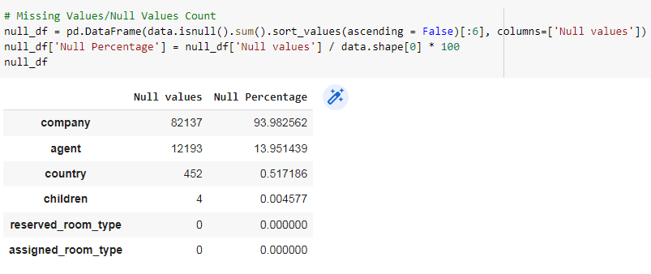
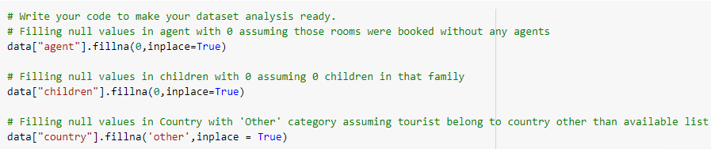
Data Cleaning and Manipulation :
Handlin Null Value :- Columns company, agent, country and children

Slide 9
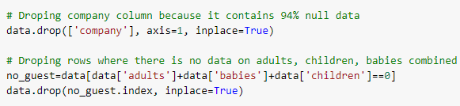
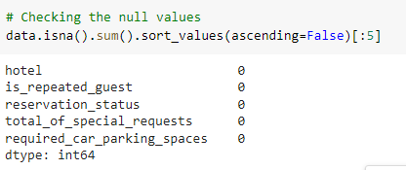
Data Cleaning and Manipulation :
2. Dropping irrelevant columns and rows :-
Here we have check the null values in the columns, its present or not

Slide 10
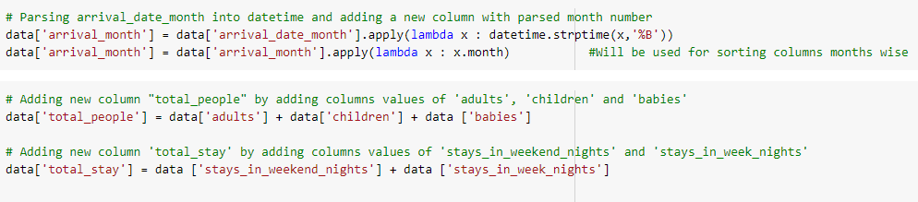
Data Cleaning and Manipulation :
3. Parsing date string into Datetime format
Adding new columns of Arrival month, Total People and Total Stay

Slide 11
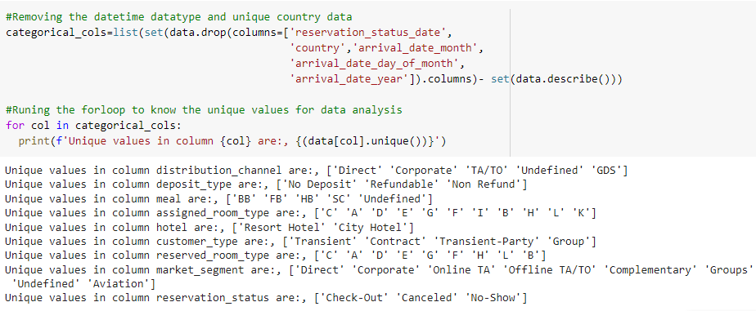
Check Unique Values for each variable

Slide 12
Exploratory Data Analysis(EDA)
Data Visualization, Storytelling & Experimenting

Slide 13
All these Question that were asked in the EDA.
Which type of hotel is mostly preferred by the guests?
From which country most guests are coming?
Which is the most preferred room type by the customers?
Which type of food is mostly preferred by the guests?
Which year had the highest bookings?
In which month most of the bookings happened?
Which Distribution channel is mostly used for hotel bookings?
What is the percentage of cancellation?
Which Agent made the most bookings?
What is the percentage of repeated guests?
What is the Optimal length of stay in both types of hotels ?
What is the reservation status from different distribution Channels ?
Correlation Heatmap?

Slide 14
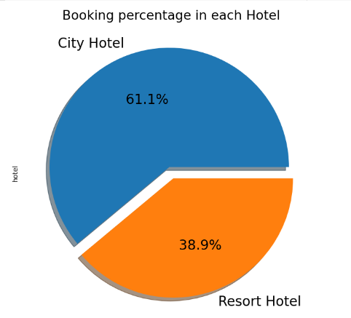
EDA
1.Which type of hotel is mostly preferred by the guests?
INFERENCE
Majority of the guest prefer City Hotel over Resort Hotel 2/3rd of total guest prefer City Hotel

Slide 15
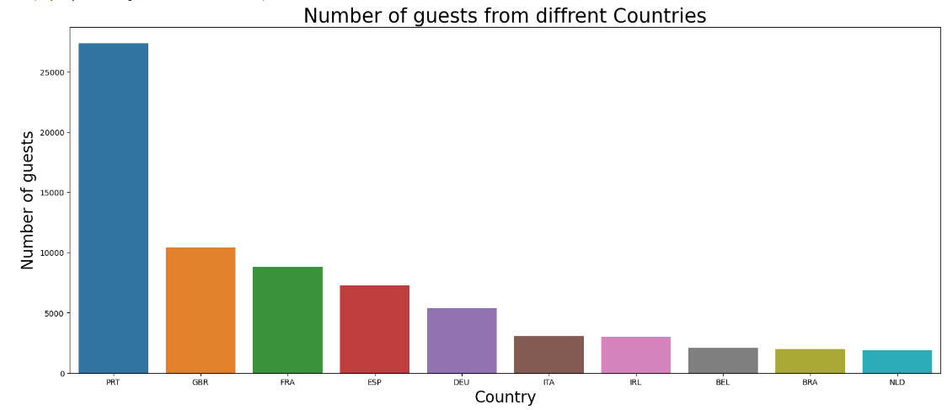
EDA
2.From which country most guests are coming?
Abbreviations for countries
PRT- Portugal
GBR- United Kingdom
FRA- France
ESP- Spain
DEU - Germany
ITA -Itlay
IRL - Ireland
BEL -Belgium
BRA -Brazil
NLD-Netherlands

Slide 16
EDA
2.From which country most guests are coming?
Abbreviations for countries
PRT- Portugal
GBR- United Kingdom
FRA- France
ESP- Spain
DEU - Germany
ITA -Itlay
IRL - Ireland
BEL -Belgium
BRA -Brazil
NLD-Netherlands
INFERENCE
From plotted bar plot, its evident that most of guest visiting these City hotels and Resort hotels are from Portugal and other European countries namely Britain, France, Spain and Germany. Among which Portugal takes the lion's share with more than 25000 customers.

Slide 17
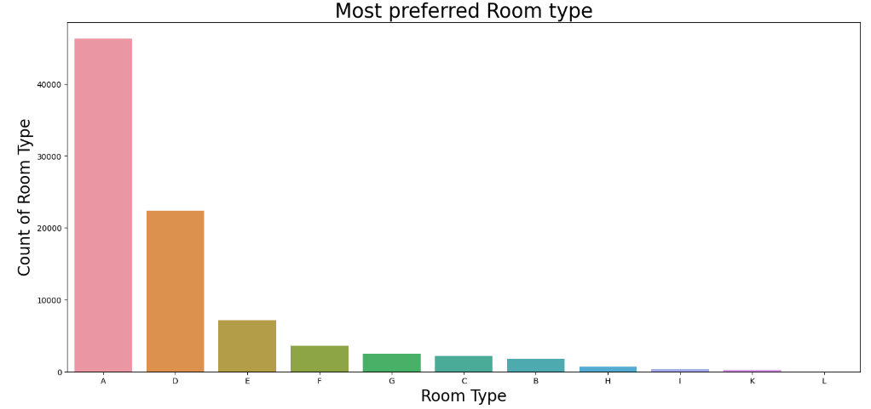
EDA
3.Which is the most preferred room type by the customers?
INFERENCE
Most demanded room type is A, followed by D and E.

Slide 18
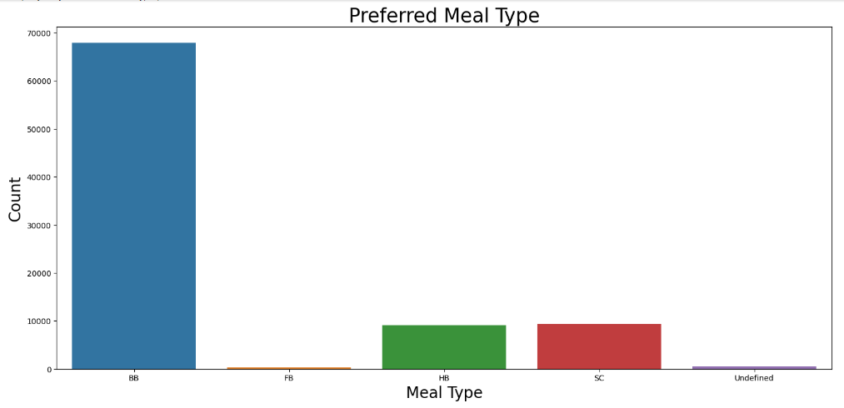
EDA
4.Which type of food is mostly preferred by the guests?
Types of meal in hotels:
BB - (Bed and Breakfast)
HB- (Half Board)
FB- (Full Board)
SC- (Self Catering)
INFERENCE
A) The most preferred meal type by the guests is BB(Bed and Breakfast)
B) HB- (Half Board) and SC- (Self Catering) are equally preferred.

Slide 19
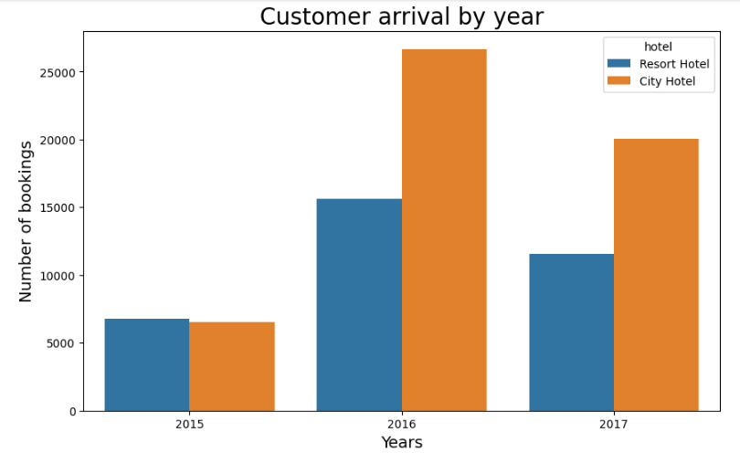
EDA
5.Which year had the highest bookings?
INFERENCE
As we can see that 2016 was the year where number of hotel booking was highest followed by total bookings in 2017 and 2015.
Overall City hotel had the highest number of bookings compared with Resort Hotel.

Slide 20
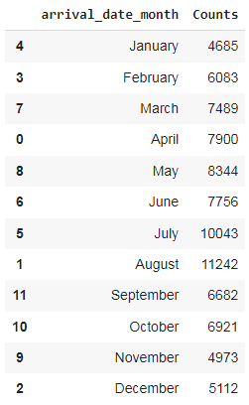
EDA
6.In which month most of the bookings happened?

Slide 21
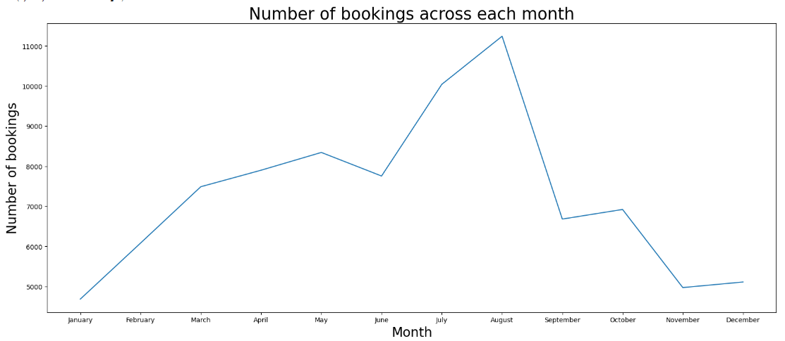
EDA
6.In which month most of the bookings happened?
INFERENCE
Peak visiting season is from mid June to August because of summer breaks in Europe Off season is from November to February because of cold weather throughout Europe

Slide 22
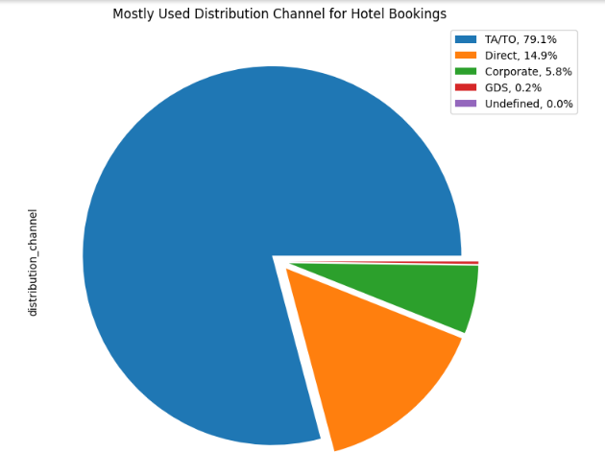
EDA
7.Which Distribution channel is mostly used for hotel bookings?
INFERENCE
As we can see, Resort hotel and City hotel are getting most of bookings from travel agency and tour operators. May be in future they will be monopolize the entire booking channel.

Slide 23
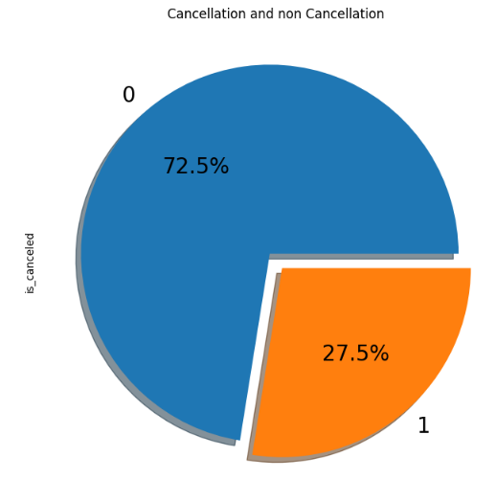

EDA
8.What is the percentage of cancellation?
INFERENCE
27.5 % of the bookings were cancelled, while 72.5% were not cancelled.

Slide 24
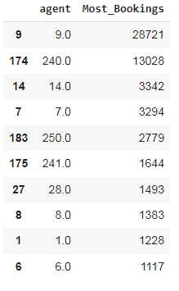
EDA
9.Which Agent made the most bookings?
INFERENCE
Agent ID No. 9.0 made most of the bookings, followed by 240.0

Slide 25
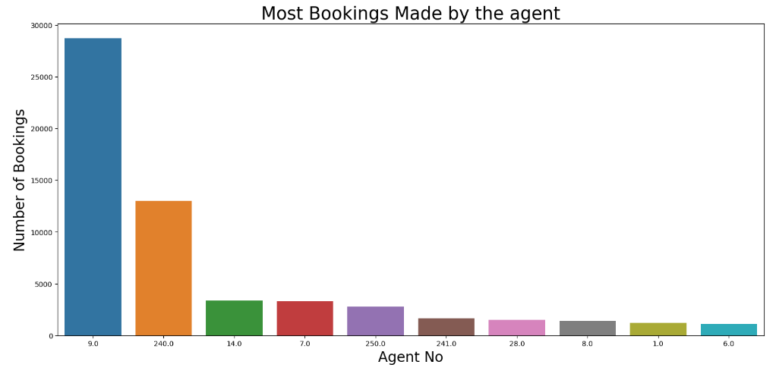
EDA
9.Which Agent made the most bookings?
INFERENCE
Agent ID No. 9.0 made most of the bookings, followed by 240.0

Slide 26
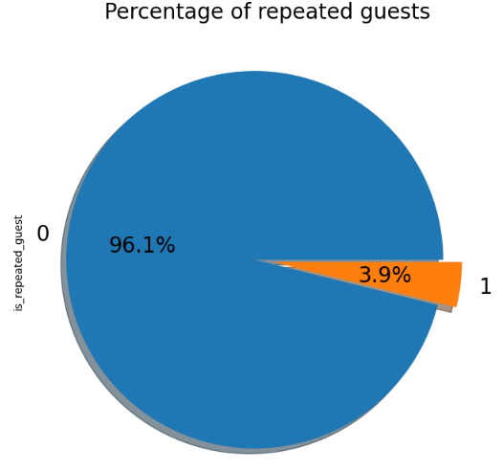
EDA
10.What is the percentage of repeated guests?
INFERENCE
Repeated guests are very few which only comprise of 3.9 %.

Slide 27
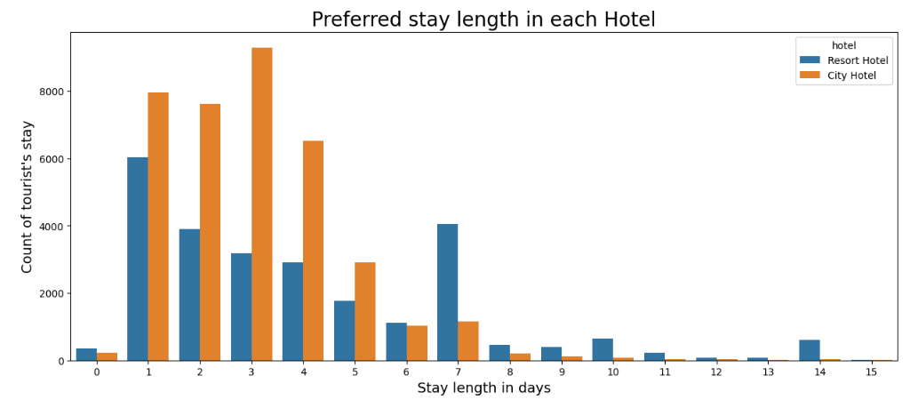
EDA
11 - What is the Optimal length of stay in both types of hotels ?
INFERENCE
Guest prefer 1-4 days when staying in City Hotels.
Guest prefer 1-4 days when staying in Resort Hotels as well, while 7 days stay is also a popular choice among guests.

Slide 28
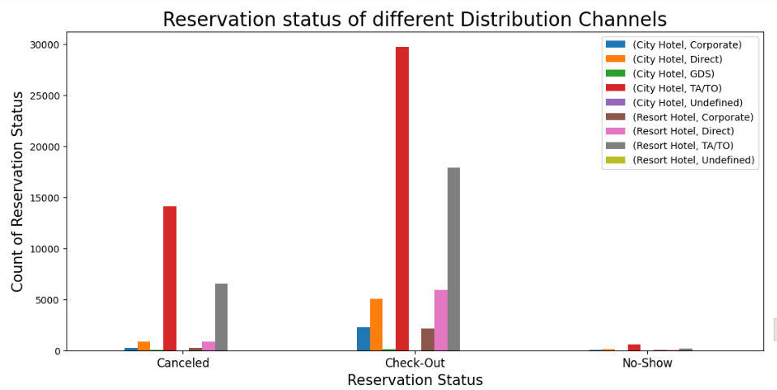
EDA
12. What is the reservation status from different distribution
Channels ?
INFERENCE
We can infer from above graph that Bookings and Cancellations from both Hotels are more from Travel agency (TA/TO).
Guest visiting both hotels, Directly and via Corporate are less likely to cancel their booking.
We can notice a very small proportion of guest booking via Travel agency not showing up at Hotel.

Slide 29
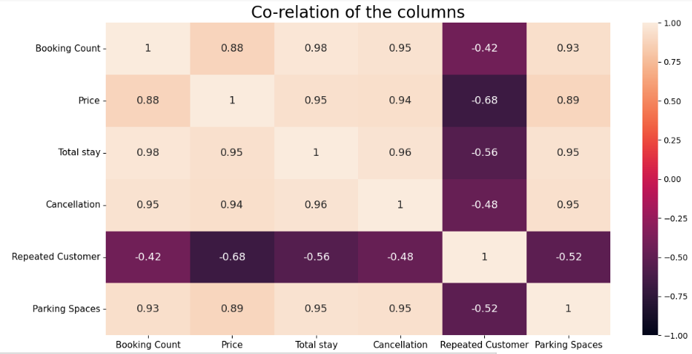
EDA
13 . Correlation Heatmap

Slide 30
EDA
13 - Correlation Heatmap
INFERENCE
There is a high positive correlation between Booking and Pricing, Total Stay, Cancellations and Parking spaces, where as negative correlation with Repeated guests
Increase in Pricing leads to repeated Customers not visiting again
There is firm correlation between Parking space and Cancellation inferring that people are more likely to cancel their booking if Parking space is not available.

Slide 31
Solution to Business Objective
What do you suggest the client to achieve Business Objective ?
In order to achieve the business objective, i would suggest the client to make the price dynamic, introduce offers and packages to attract new customers. To retain the existing customers and ensure their repetition the client must introduce loyalty points program which can be redeemed by the customers in their next bookings. Amenities such as parking spaces, kids corner, free internet connection can be provided to increase the number of bookings.

Slide 32
Conclusion :
Majority (61%) of the guests prefer City Hotel over Resort Hotel. Most of guest visiting these hotels are from European countries namely Portugal, Britain, France, Spain and Germany totaling to 75% of total booking count.
2016 observed the highest booking reservations. From Booking trend it can be inferred that Peak visiting season is from mid June to August because of summer breaks in Europe while November to February is off season because of freezing cold weather throughout Europe.
Around 11.5% of total reservations throughout year are coming from August whereas January has the least reservation of mere 5%. Guests can consider visiting these hotels during month of June and September to enjoy decent weather with almost full availability of hotels accommodation.
Inspecting different market segments, it was concluded that travel agency holds monopoly as both hotels are getting the most of booking from travel agency (around 79%). Hotel owners should consider promoting their hotels more in different market segments to penetrate market more.

Slide 33
Conclusion :
Interestingly, most of the Cancellations for both Hotels are from Travel agency (TA/TO) segment inferring that it is volatile market segment. Also, a very small proportion of guest booking via Travel agency do not showing up at Hotel. Guest visiting both Hotels directly and via Corporate are less likely to cancel their booking.
There is high positive correlation between Booking, Pricing, Total Stay, Cancellations and Parking spaces whereas negative correlation with Repeated guests. With increase in Booking --> Pricing, Total stay and Parking spaces occupation increases but increase in Pricing leads to repeated Customers not visiting again.
There is firm correlation between Parking space and Cancellation inferring that people are more likely to cancel their booking if Parking space is not available.
Only 3.9 % people revisited the hotels. Rest 96.1 % were new guests. Thus retention rate is low.
Ideally guest prefer to stay 1-4 days in both hotels but 7 days stay at Resort hotel is also a popular choice among guests.

Slide 34

THANK YOU
ALMABETTER FOR BETTER TEACHUNG US

